Slide 1
Optimus Solutions
Kavya Purushothaman
Shruthi Nair
Mihir Mohite
Prachit Puranik
Ajay Iyer
12/6/2019

Slide 2
Background
Users:
Primary - EVC System Administrators (Maintain data, Generate reports etc)
Secondary - Other EVC System Employees (Higher-ups to monitor performance, make strategic decisions etc)
Data/Sources:
Location information from DOTS website - https://transportation.umd.edu/sites/default/files/ev-charging-map.pdf
Location, Driver, Vehicle, Station & Payment information - Created dummy data
Business processes & transactions were formulated using information given on website & adding some logical assumptions - https://transportation.umd.edu/about-us/updates/new-ev-policy-2019

Slide 3
Introduction
Mission Statement:
The purpose of the Optimus Solutions Electronic Vehicle Charging database is to generate and store the required data for the EVC system which can be used for their day-to-day business operations.
Mission Objectives:
The objectives of this database management system are -
To track total number of transactions per month
To calculate total revenue generated per month
To track total number of transactions at each location and the revenue generated from each
To check how often a particular payment mode is used by users and the revenue by each mode
To check how much revenue is generated by drivers with and without a permit

Slide 4
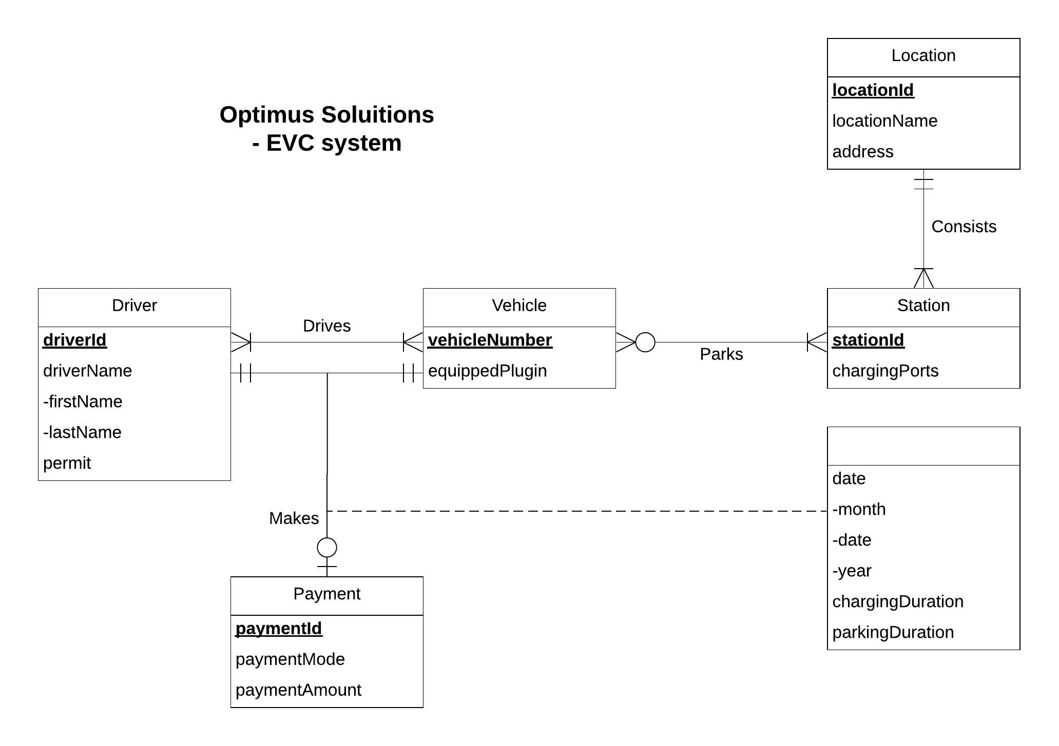
Conceptual Database Design

Slide 5
Logical Database Design
Location (locationId, locationName, address)
Driver (driverId, firstName, lastName, permit)
Vehicle (vehicleNumber, equippedPlugin)
Payment (paymentId, paymentMode, paymentAmount)
Station (stationId, locationId, chargingPorts)
Drives (driverId, vehicleNumber)
Parks (stationId, vehicleNumber)
Makes (driverId, vehicleNumber, paymentId, month, day, year, parkingDuration, chargingDuration)

Slide 6
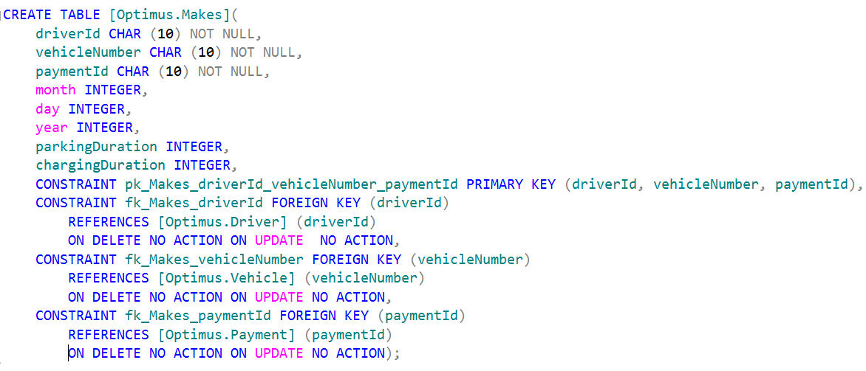
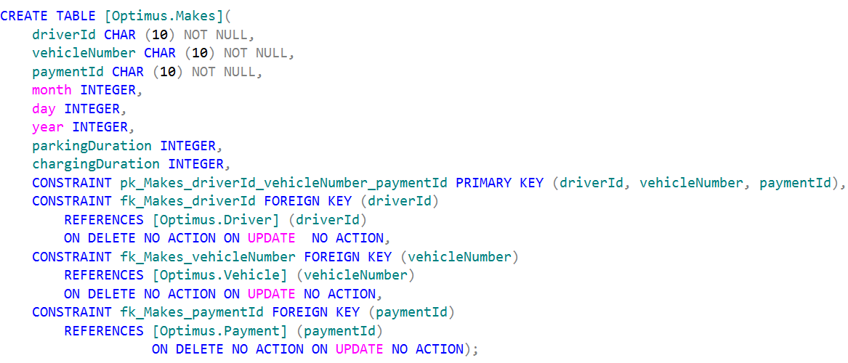
Physical Database Design

Slide 7
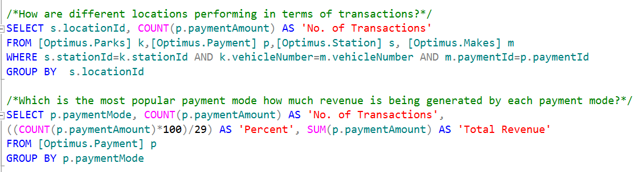
Use Cases (Two Business Transactions)

Slide 8
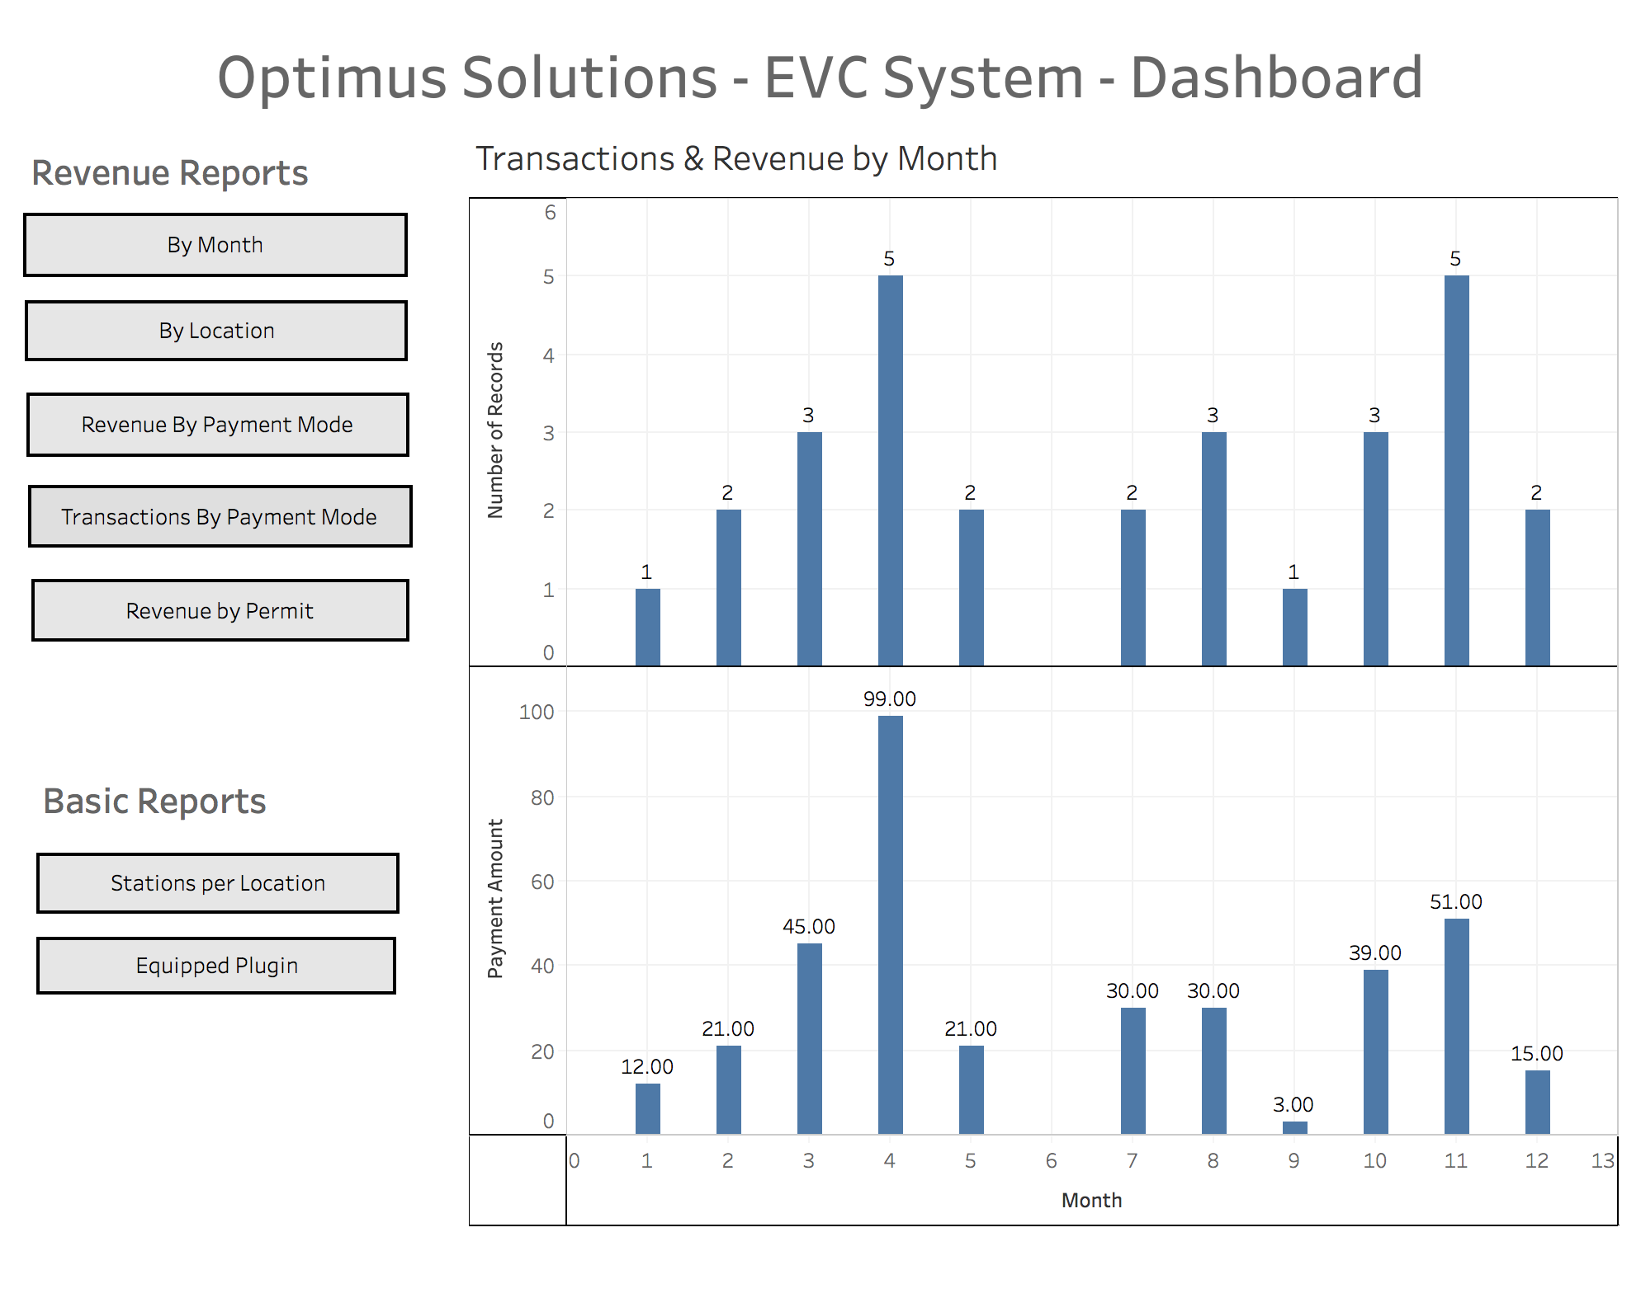
User Interface - Tableau Dashboard

Slide 9
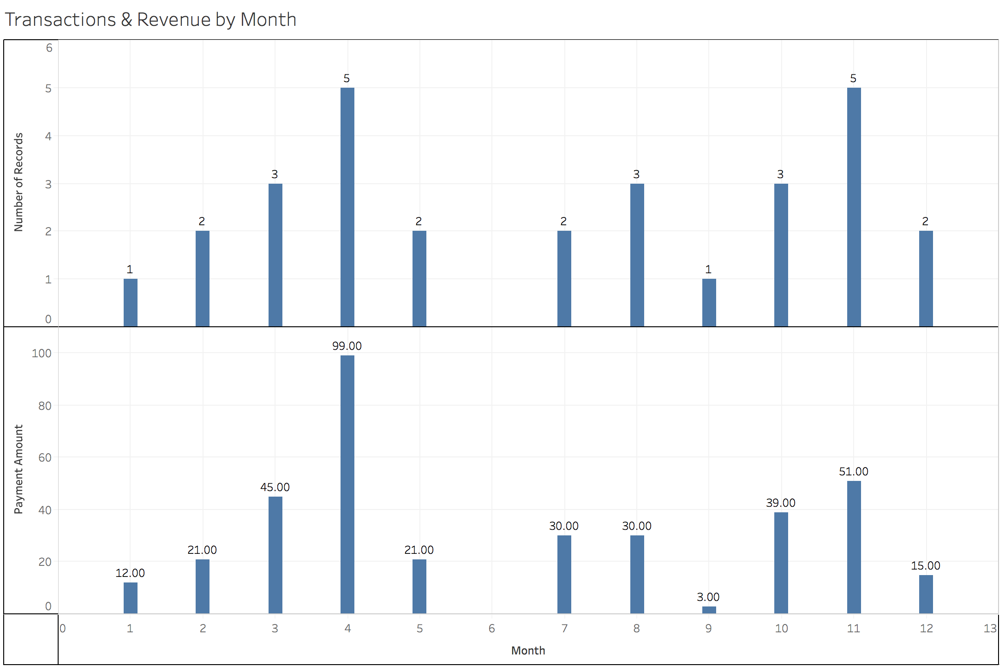
Application - Revenue & Transactions by Month
Question - What are the total number of transactions by month?
Insights - Trends/irregularities.
Actions - Check for malfunctions/performance issues.
Question - What is the total revenue for each month?
Insights - Are there any trends, irregularities?
Actions - If there are any issues/malfunctions etc, it can be easily identified.

Slide 10
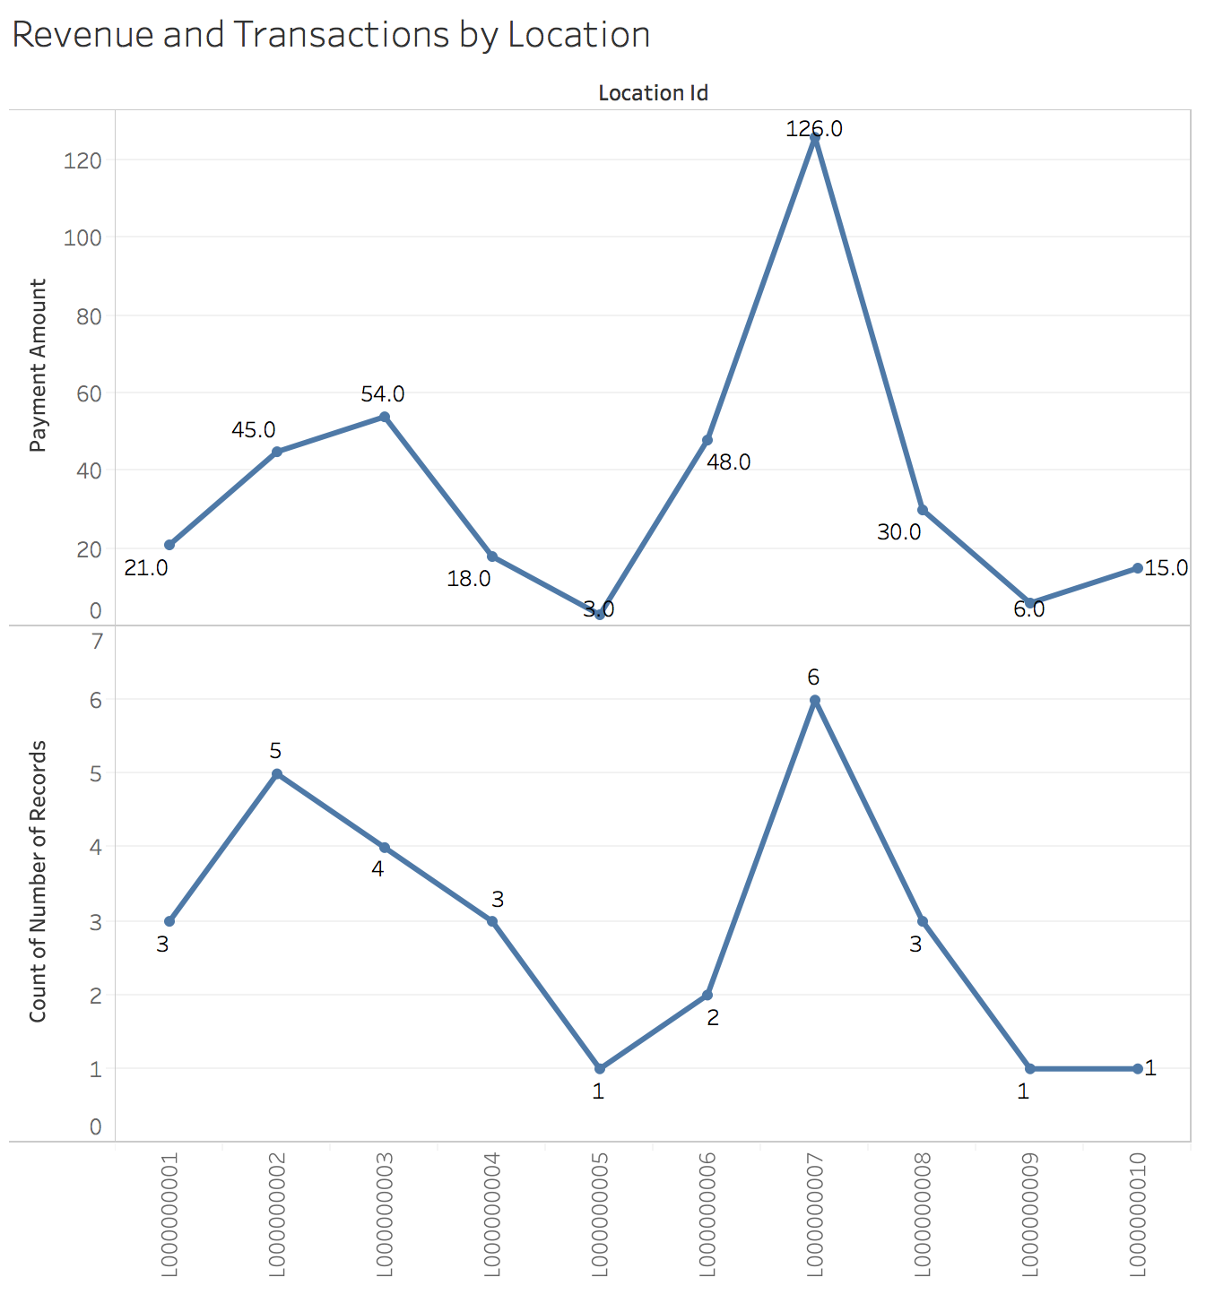
Application - Revenue & Transactions by Location
Question - How are different locations performing in terms of revenue?
Insights - Identify trends. Here Location 7 is performing best.
Actions - Check if we need more charging stations at popular locations which can lead to increase in revenue.
Question - How are locations performing in terms of number of transactions?
Insights - Identify trends, most popular and least popular locations.
Actions - Check if there are any issues (glitches etc) at least performing stations. Check if we need more stations at most popular locations.

Slide 11
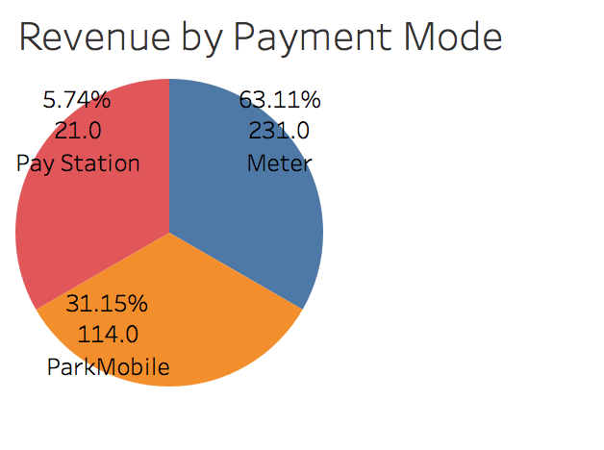
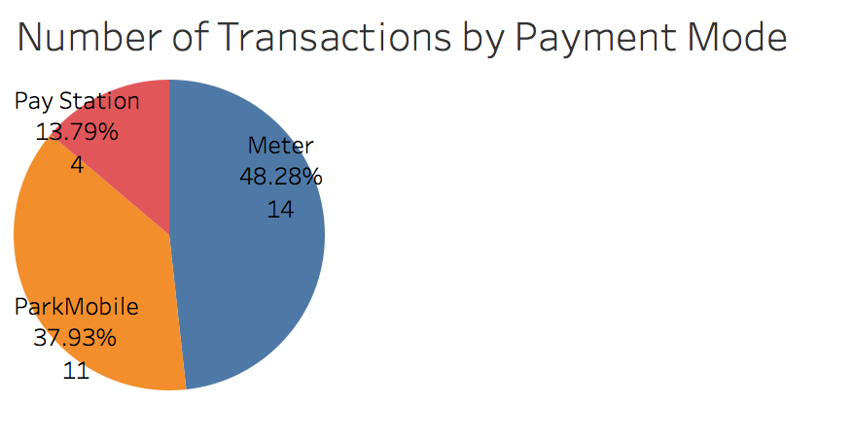
Application - Revenue & Transactions by Payment Mode
Question - How are different payment modes being used? Which is the most popular payment mode?
Insights - Pay Station is the least used mode and Meter is the most used.
Actions - Check why Pay Station is not being used much? Check for any performance restrictions/difficulties customers face while using this mode. If no such items identified, analyse if we need that payment mode.

Slide 12
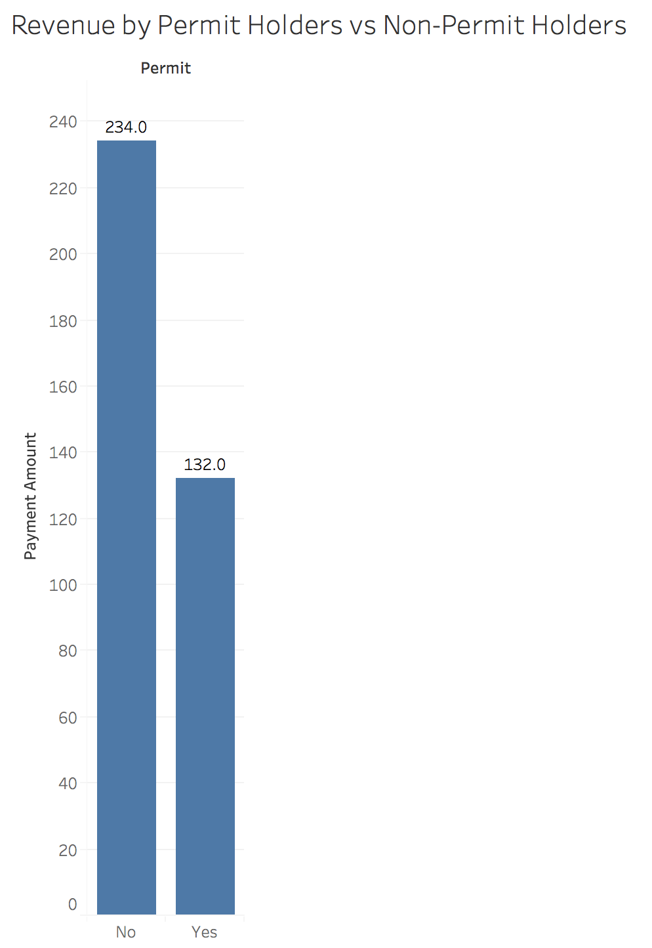
Application - Revenue by Permit and Non-permit Holders
Question - What is the revenue distribution amongst drivers with and without a campus permit? Are there a lot of drivers with permit who are still generating revenue?
Insights - If there are a lot of drivers with permit generating revenue, it means there is overcharging issue.
Actions - This can be further drilled down to see which location has maximum overcharging issue and adequate monitoring can be done to combat this.

Slide 13
Thank You!

